Slide 1

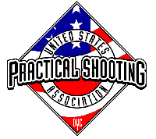
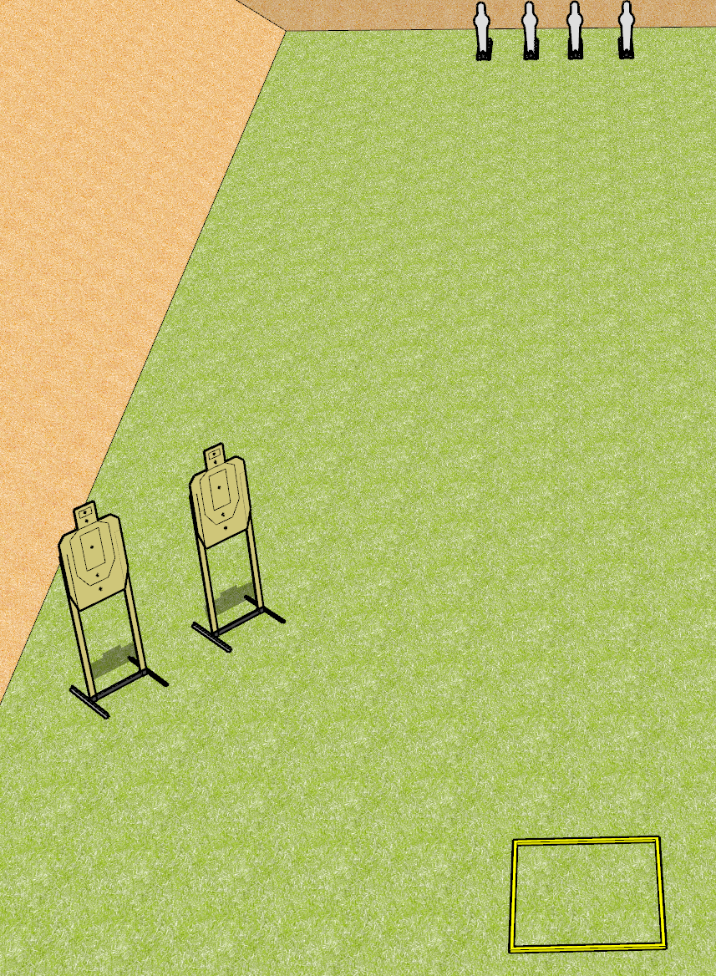
 | Dothan Gun Club – USPSA Match Throttle Control Course Designer : Drew Coleman
Round Count 8 rounds 2 USPSA 4 mini poppers
Equipment List 2 USPSA Shooting box

Slide 2
Throttle Control
Written Stage Briefing
Throttle control is an 8 round, 40 point, Comstock course of fire. There are 2 USPSA targets and 4 mini poppers. The best 2 hits on paper will score, and steel must fall to score. The start signal is audible.
Handgun start position is inside the shooting area, wrists above shoulders. Handgun is loaded and holstered.
PCC start position is inside the shooting area, stock on belt. Loaded carbine is held with both hands, safety on.
On start signal, engage targets as they become available from within the shooting area.

